Slide 1

Medino Pharmacy
Name: Daisyna Shrestha
NCC-ID: 00172899
Subject: Computing Project
Date: 23rd April, 2019

Slide 2
Introduction
Medino, a web-based pharmacy management system.
Also known as drug information system.
Enable user to access medicine information from anywhere through online and purchase them.
Easy handles data and reduce paper work.
User-friendly and reliable.

Slide 3
Existing system
It requires more paper-work.
Less secure for data storage.
Manual calculation resulting budget error.
Lack of drug knowledge.
Difficulty for user in finding their required medicine.
Less reliable for correct medication

Slide 4
Background of the project
Both pharmacist and user can login into the system with unique email address.
Adding, updating and deleting medicine information are managed by pharmacist.
User can search and view medicine detail and can place their order.
Automated bill generation.

Slide 5
Aims
Computerized pharmacy system.
Secure data processing and storage.
Less paper work.
Overcome manual efforts.
Easy placing order.
Auto bill generation.

Slide 6
Objectives
User friendly user interface.
Overcoming manual efforts with automated calculation.
Validation for secure login.
Detailed information is taken from user before placing their order for right delivery.

Slide 7
Limitation
Lacks online payment system.
No user alert when their order is accepted.
Lacks validation while uploading prescribed report by user.
No deduction of quantity according to expiry date and medicine sold.

Slide 8
Features of the project - 1
Pharmacist and user login
Store medicine and its related information
Modify and delete medicine
Effective search of medicine
Display extensible list of available medicine
Upload prescription report

Slide 9
Features of the project - 2
Order medicine
Auto generate bill, save and print bill
Record customer order
User-friendly

Slide 10
MoSCoW Prioritization
MoSCoW prioritization is a technique to understand the relative importance of the work to be done.
It helps to make progress and keep deadlines.
And MoSCoW stands for:
Must Have
Should Have
Could Have
Won’t Have this time

Slide 11
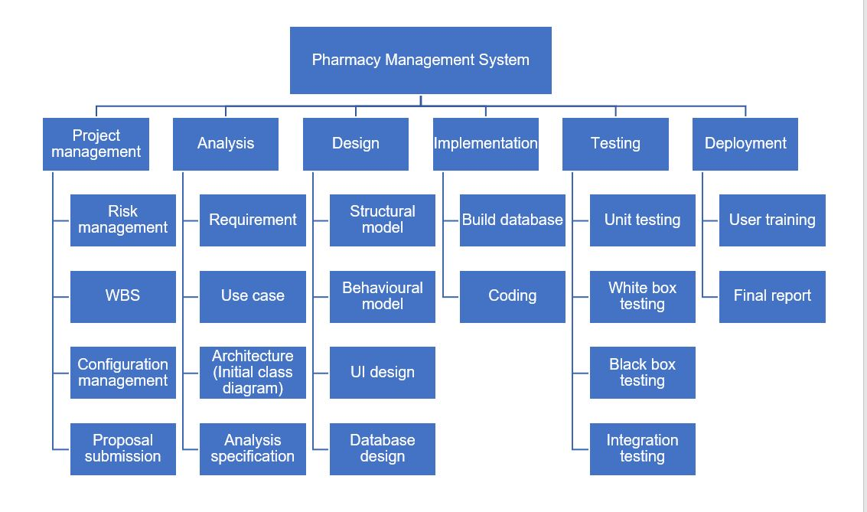
Work breakdown structure

Slide 12
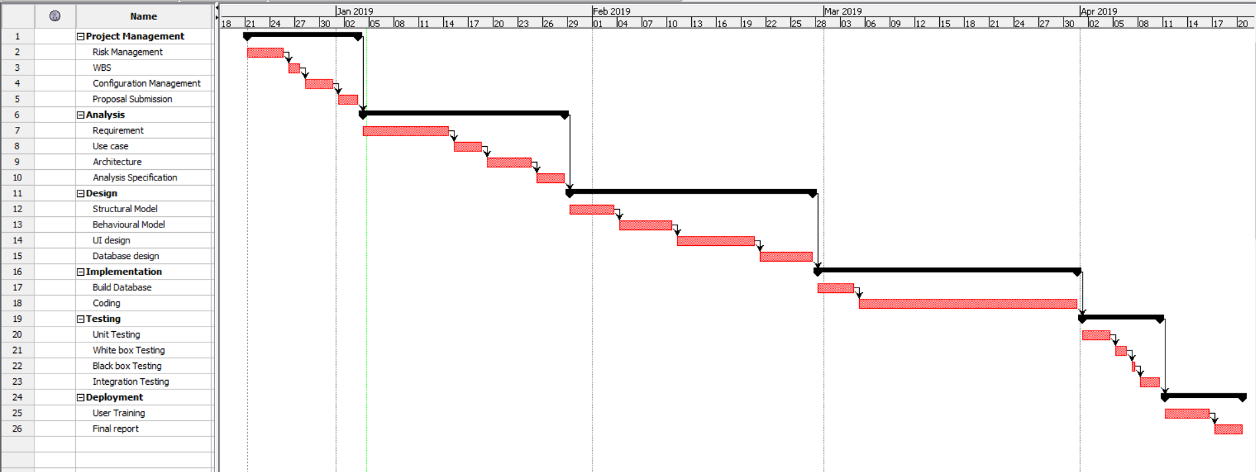
Gantt Chart -1

Slide 13
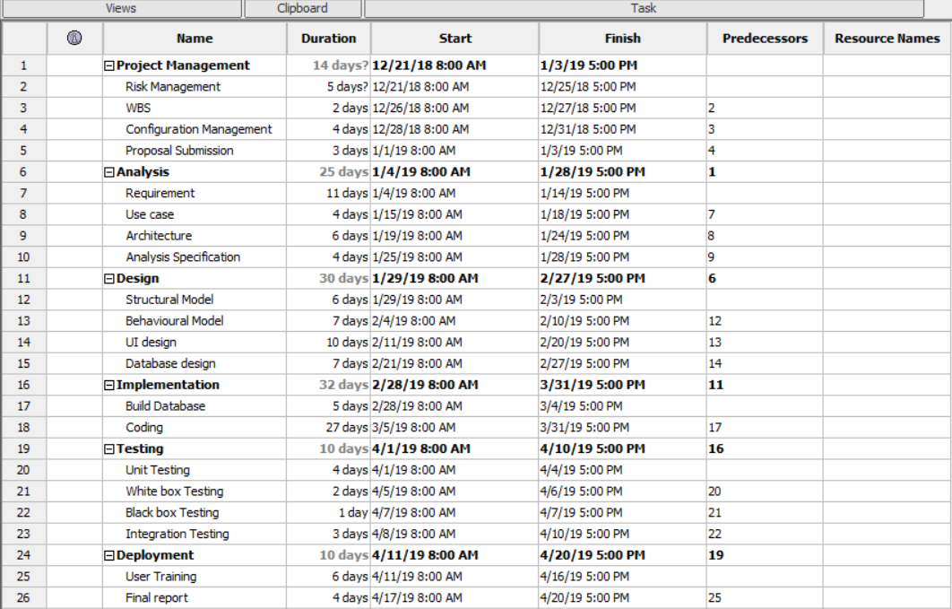
Gantt Chart -2

Slide 14
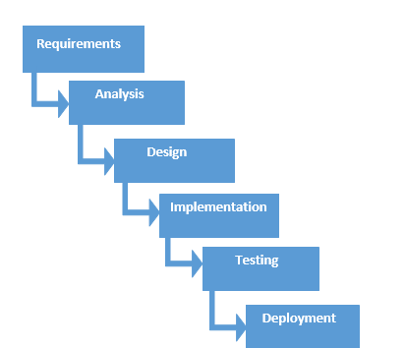
Waterfall methodology
It is linear-sequential software development model in which development is seen as flowing steadily downwards like a waterfall through phases.
Each phase must be completed before beginning another phase.

Slide 15
Why Waterfall ?
It is suitable for small project.
It is easy to understand and simple to use.
It is easy to manage and each phase has specific goals and review process.
It helps to measure project milestone.
It works well where the requirements are clear and understandable.

Slide 16
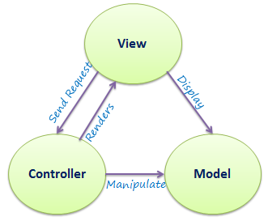
Architecture – 3-tier architecture
MVC architecture is used.
It stands for “Model-View-Controller”.
1. Model
It carries data and can contain business logic used by the program.
2. View
It represents the GUI part with which user will interact.
3. Controller
It controls the data flow into model and update view. It connects user with the system.

Slide 17
Risk management
Identification and prioritization of risks and analyzing with various tools and economical application resources to minimize their impact on the system.
It can be managed in five steps :
1. Identify the risk
2. Analyze the risk
3. Evaluate or rank the risk
4. Treat the risk
5. Monitor and review the risk

Slide 18
Configuration management
A way to maintain consistency between physical and logical assets in an operational environment throughout project life.
Identifies bad configuration changes and ensures quick service restoration.
Why?
Increased efficiency
Cost reduction
Efficient change management
Faster restoration of your service if a process failure occurs.

Slide 19
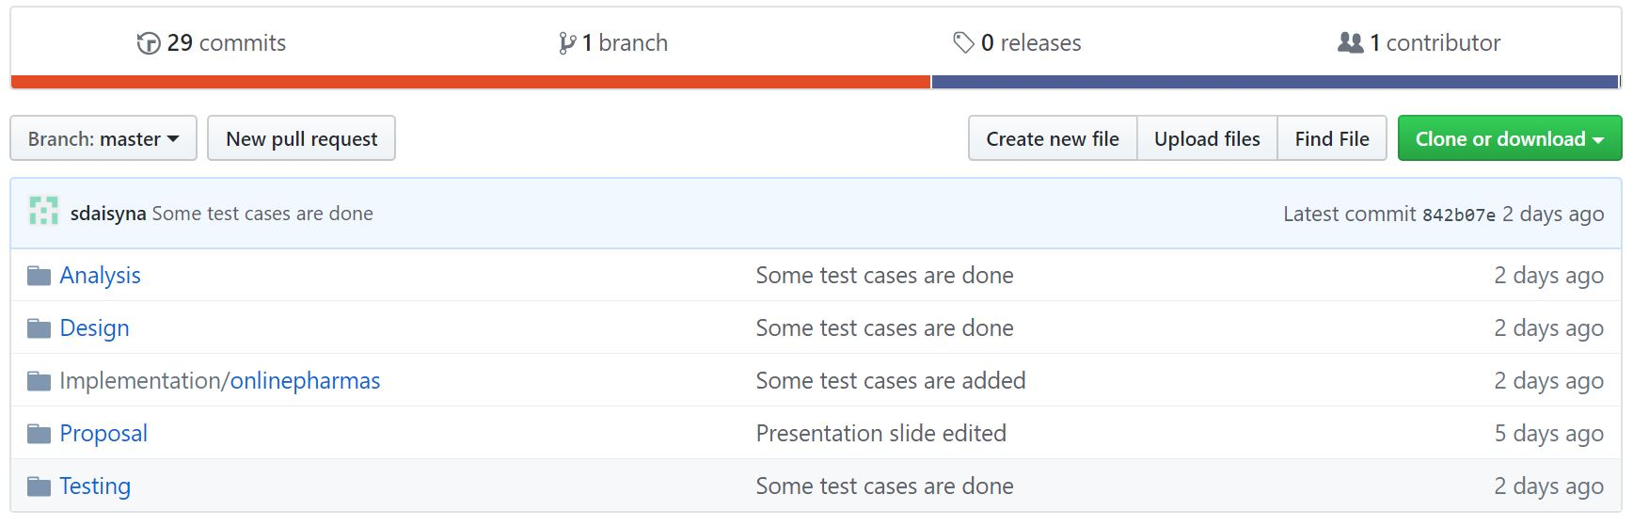

Slide 20
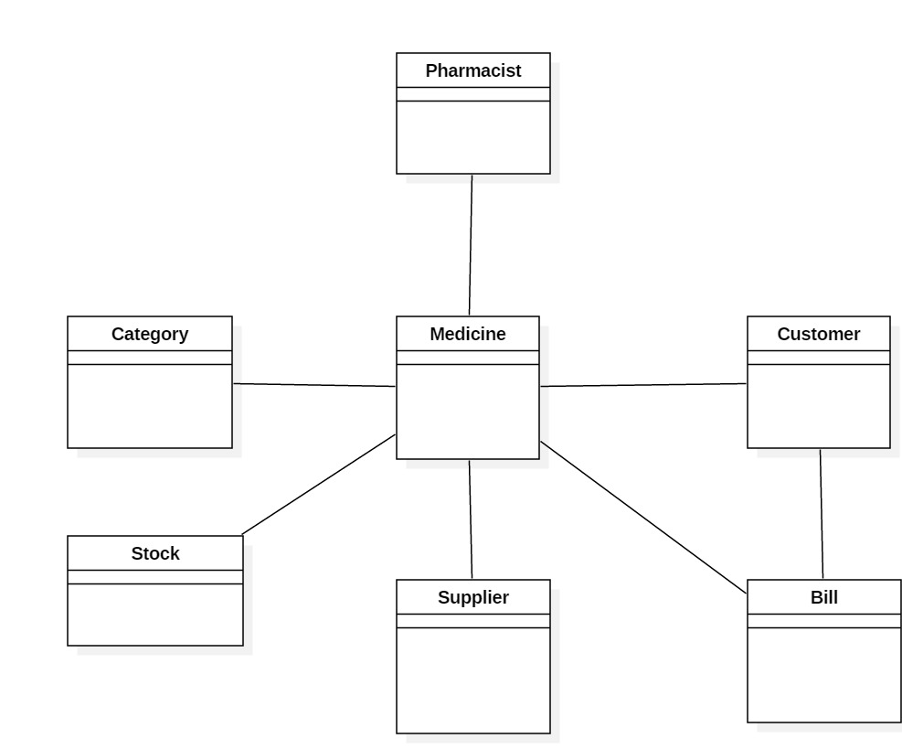
Design – Initial class diagram

Slide 21
Design – Class diagram
It is a static structure and modelling of the system.
It helps to describe general overview of the system.
Illustrates relationships and dependencies among classes present in the system.

Slide 23
Design – ER-diagram
Graphical representation that shows the relationship of entities stored in a database.
Shows datatypes and constraints of the attributes.
Illustrates the logical structure of database.
Helps to sketch out the design of a database.

Slide 24
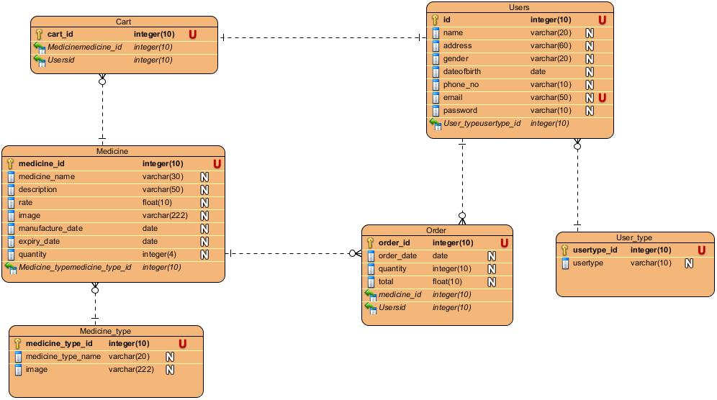

Slide 25
Design – Use case diagram
Models the functionality of the system using actors and use cases.
Valuable for visualizing the functional requirements.
Specify how system interacts with the actor.
Use case: role of user within the system.
Actor: one who perform the action

Slide 26
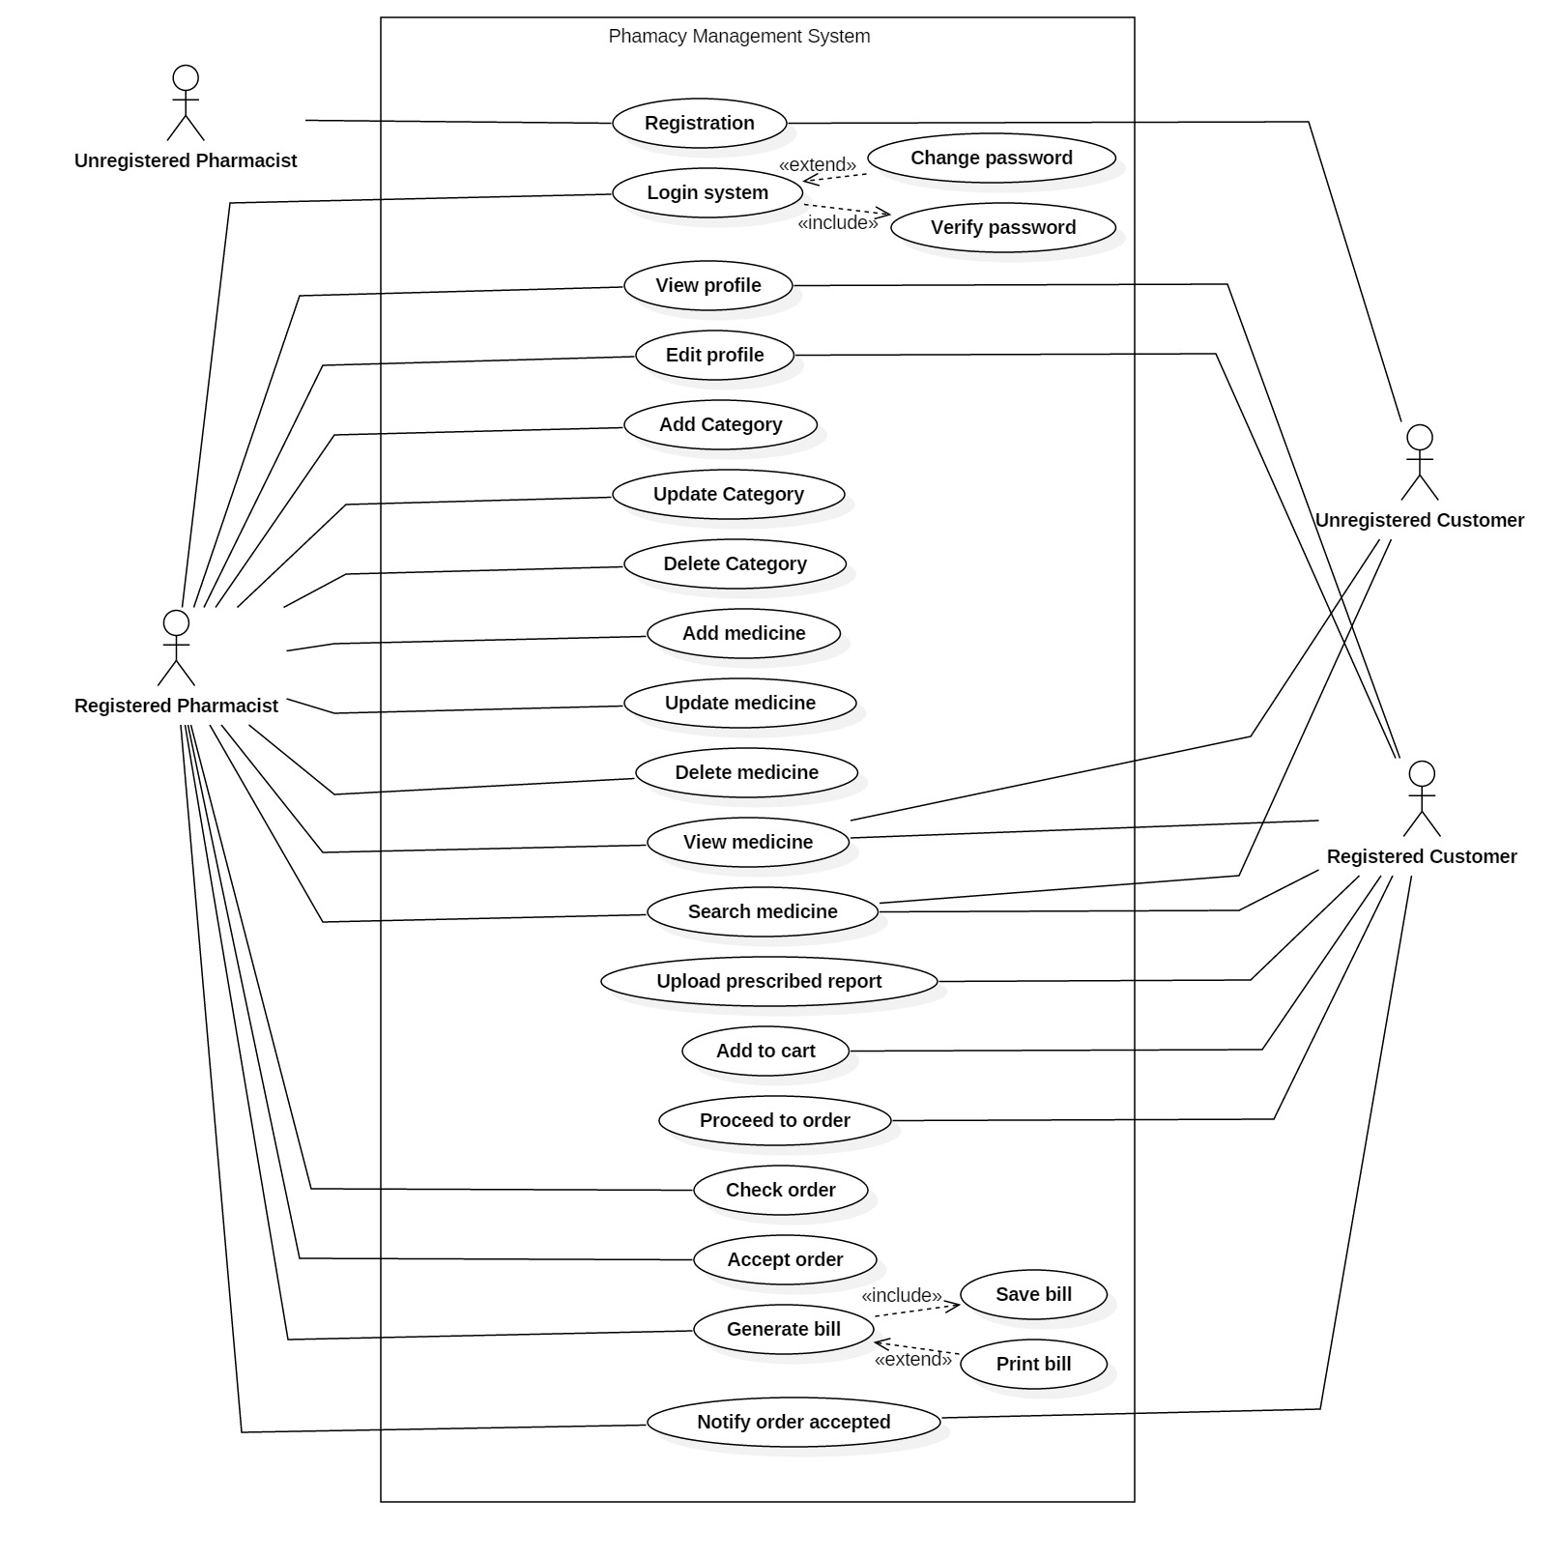

Slide 27
Design – Activity diagram
A flowchart to represent the flow from one activity to another activity.
Describes the dynamic behavior of the system.
Shows the activities performed by a system.

Slide 28
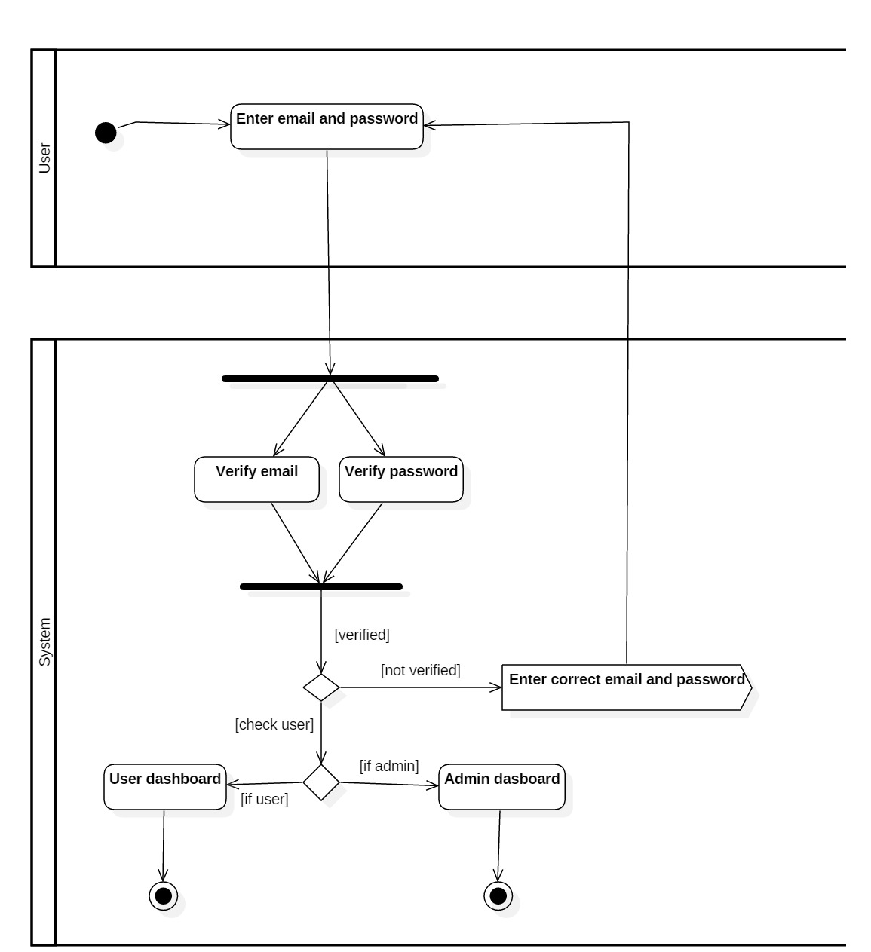

Slide 29
Design – Sequence diagram
Describes interactions among objects in terms of an exchange of message over time.
Predict how a system will behave.
Helps to achieve the sequential flow of the website.

Slide 30
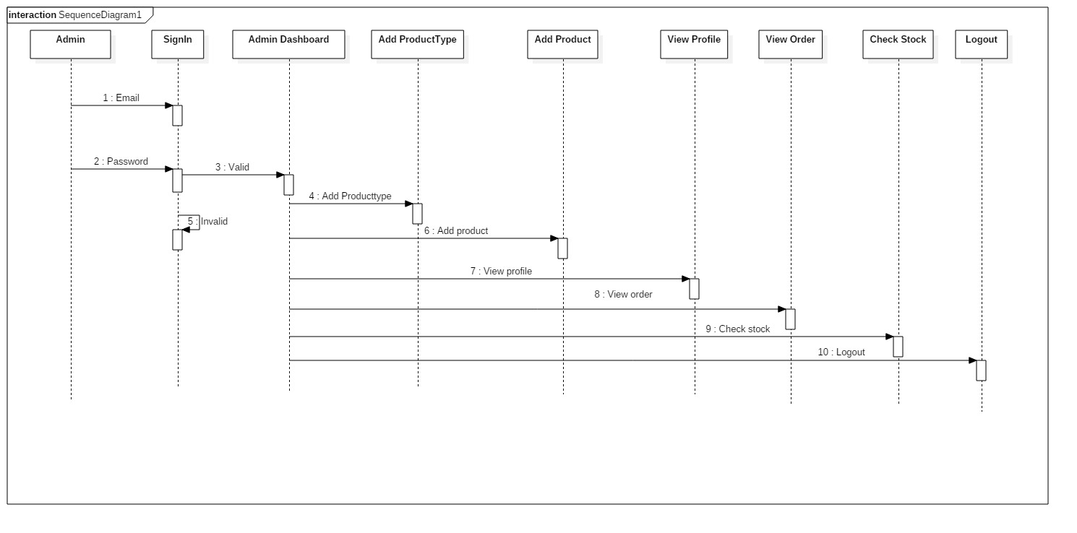

Slide 31
User interface
Typically 3 pages
Medicine page
Cart page
Receipt of bill

Slide 32
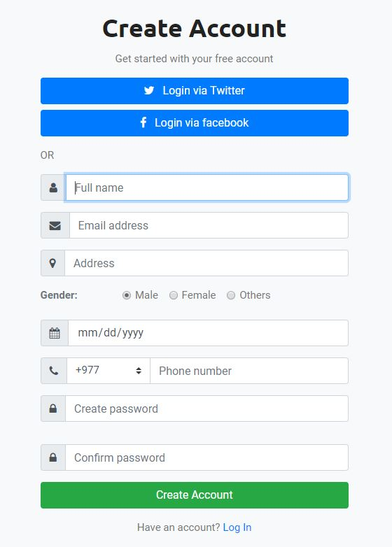
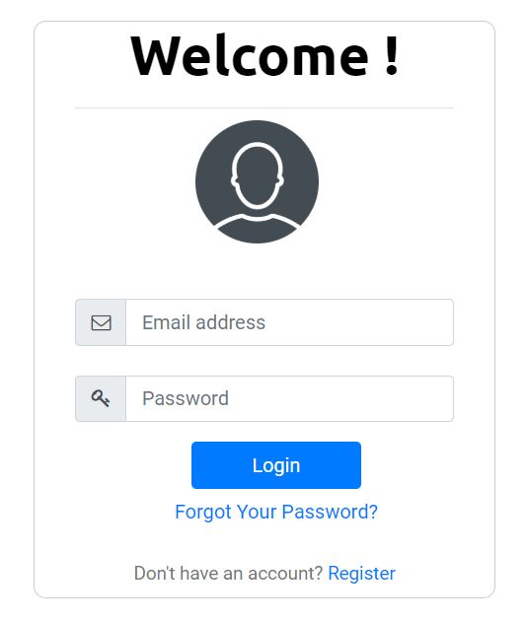
Login and Registration

Slide 33
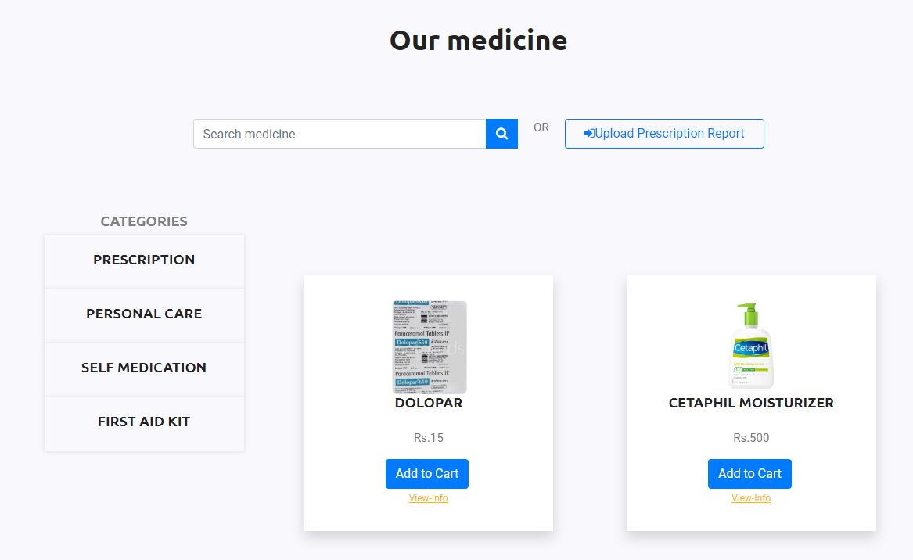
Medicine page

Slide 34
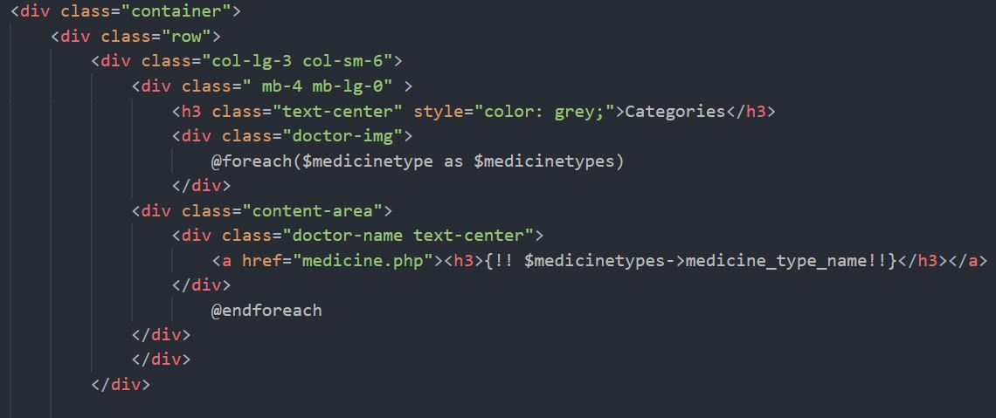
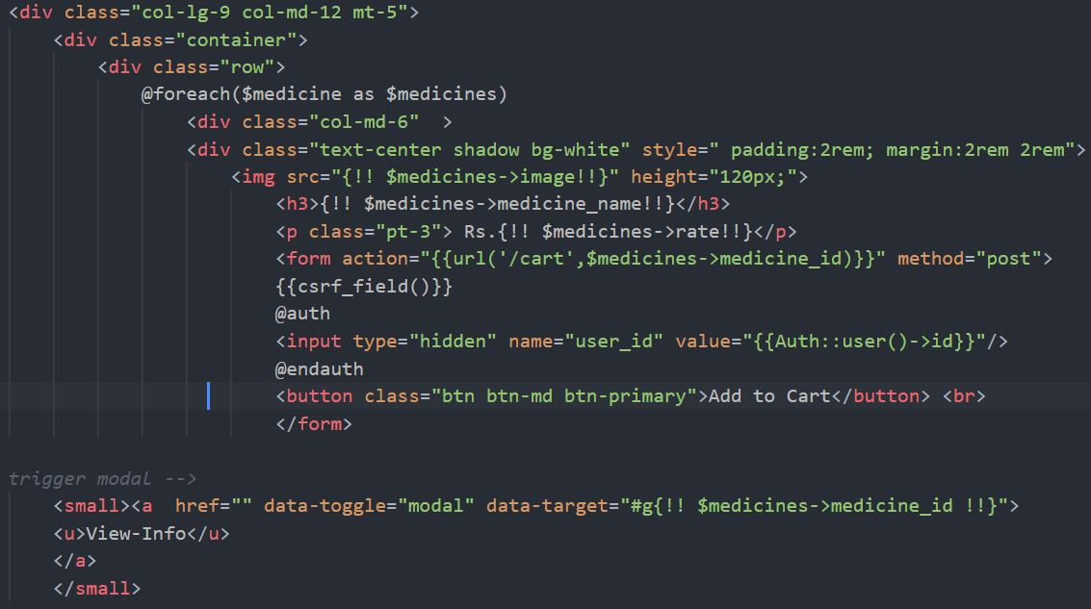

Slide 35
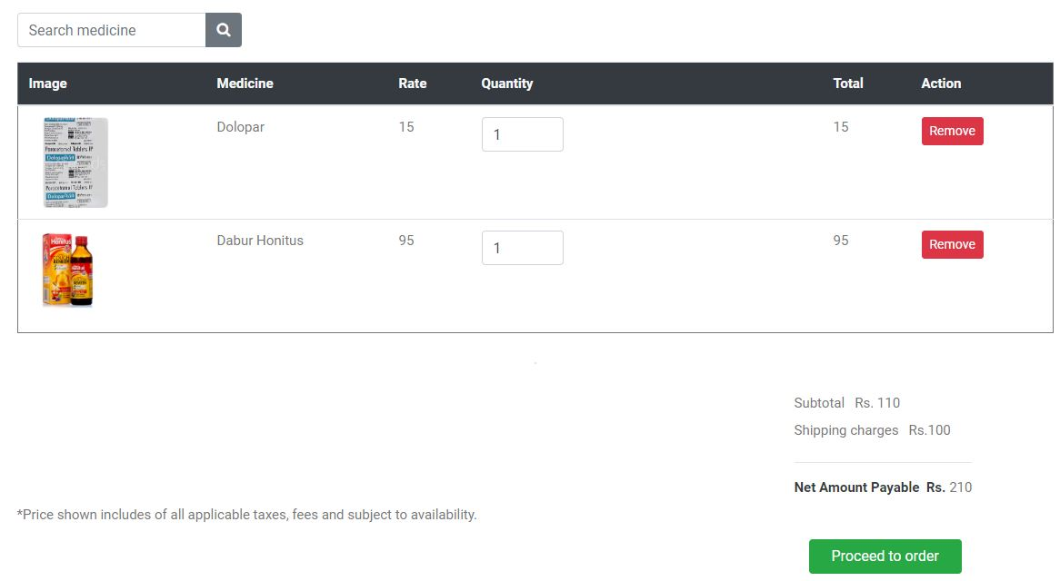
Cart page

Slide 36
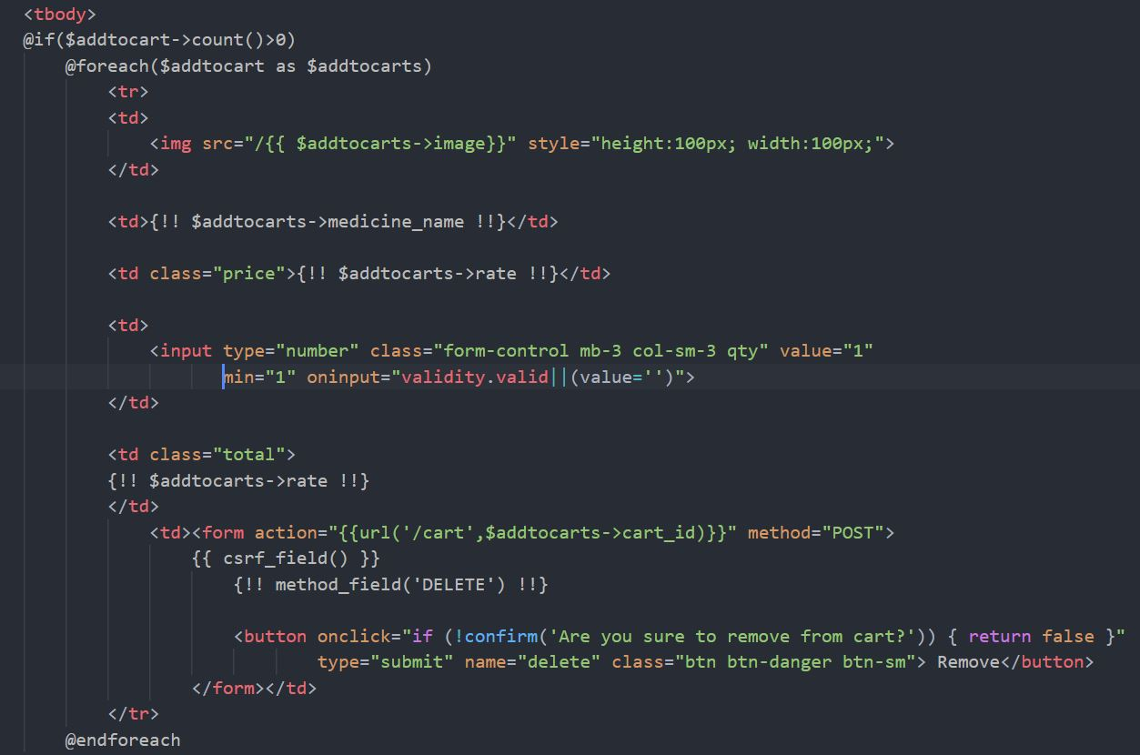

Slide 37
Receipt of bill

Slide 38
Testing
Executing a system to identify errors or missing requirements.
Ensures developed system is defect free.
And helps to produce quality product.

Slide 39
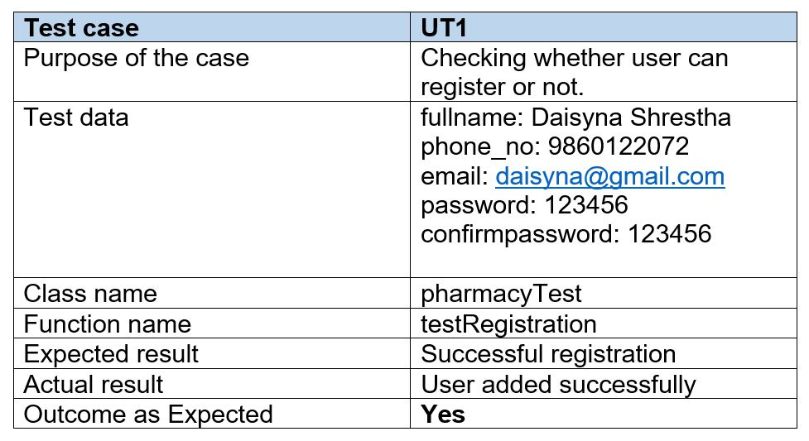
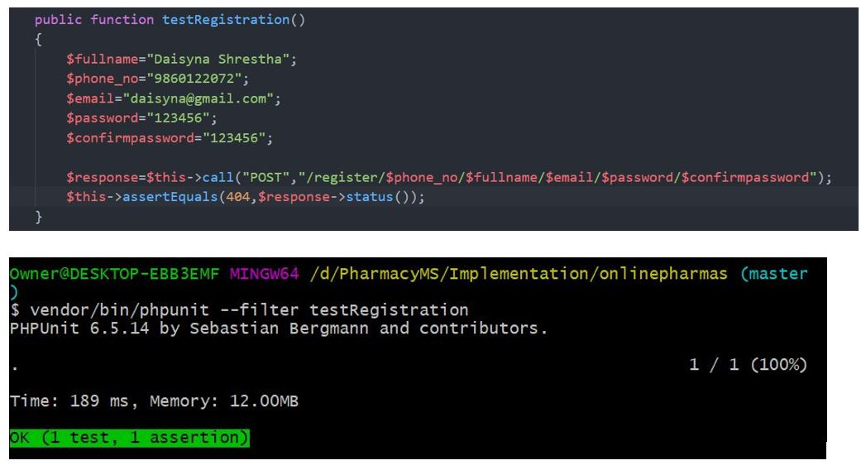
Test case -1 (Unit testing)

Slide 40
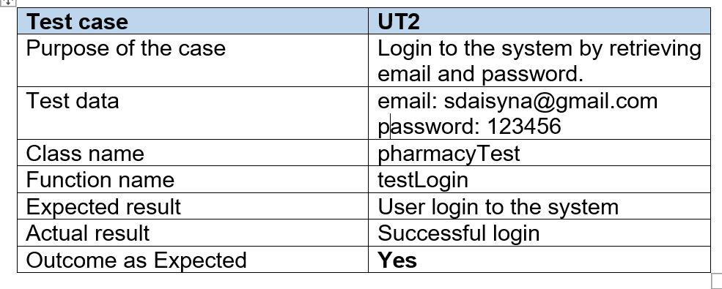
Test case - 2

Slide 41
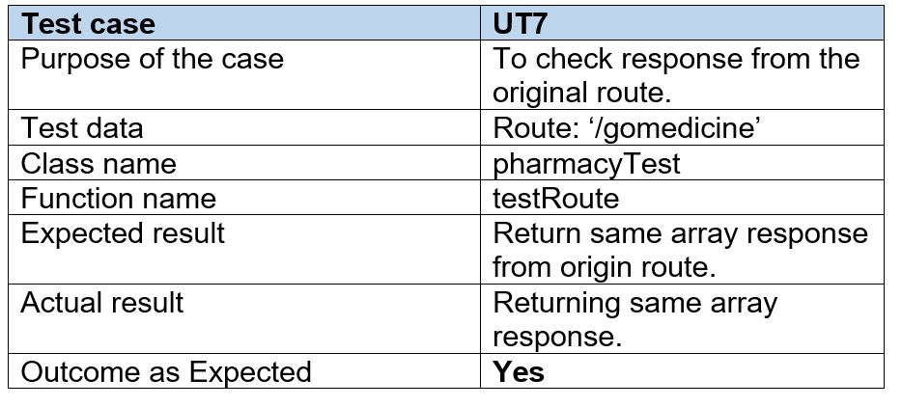
Test case - 3

Slide 42
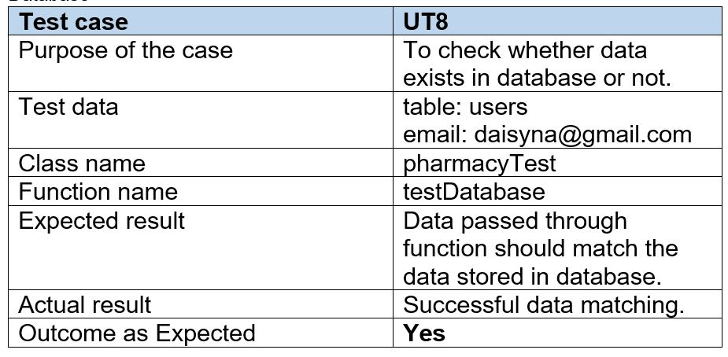
Test case - 4

Slide 43
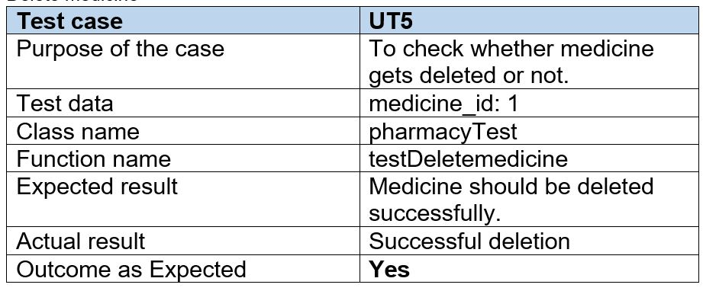
Test case - 5

Slide 44
Test case -6 (Black box Testing)

Slide 45
Future work
Online payment system.
Validating and verifying prescribed report after uploading.
Notification alert when order is accepted.
Automatic deduction of medicine quantity according to expiry date and medicine sold.
Accessibility function

Slide 46
User manual

Slide 47
Conclusion
The project I had developed will help pharmacy to keep their medicine data secure and help customer to order their required product in easy way.

Slide 48
References
https://www.interserver.net/tips/kb/mvc-advantages-disadvantages-mvc/
https://www.tutorialspoint.com/sdlc/sdlc_waterfall_model.htm
https://c2sconsultinggroup.com/the-importance-of-configuration-management/
https://www.slideshare.net/HabtamuAsmare/pharmacy-management-system-requirement-analysis-and-elicitaion-document

Slide 49
Any question ?

Slide 50
Thank you !

